Slide 1

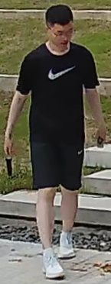
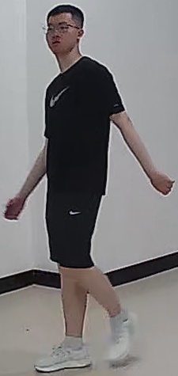
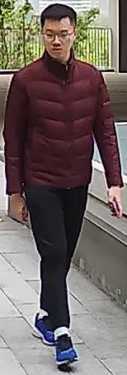
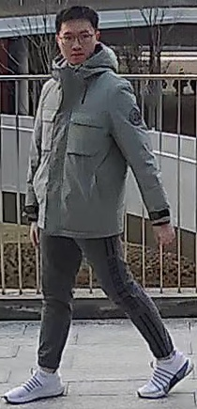
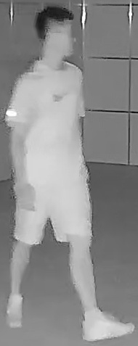
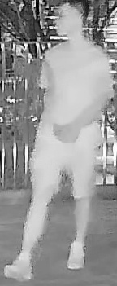
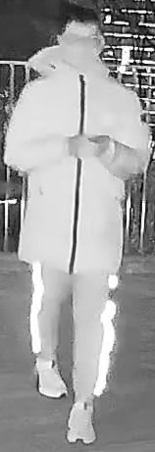
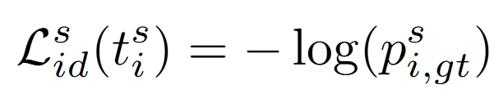
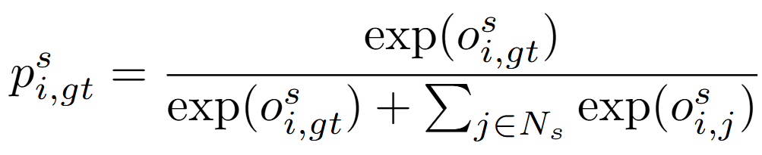
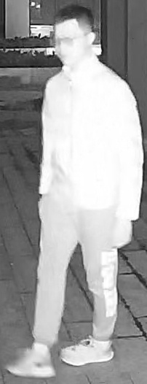

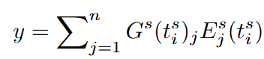
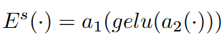
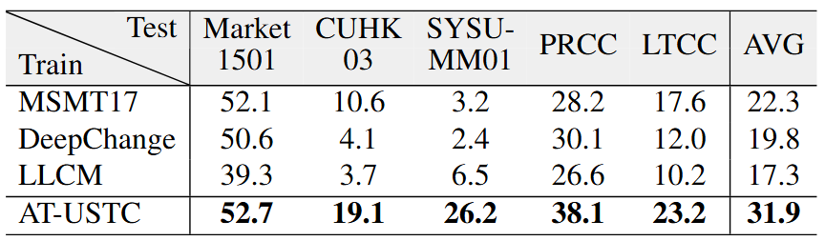
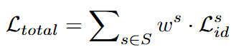
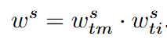

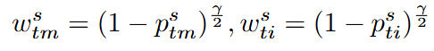
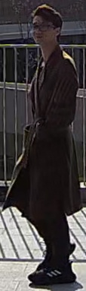
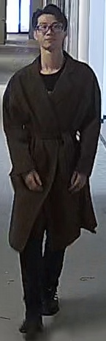
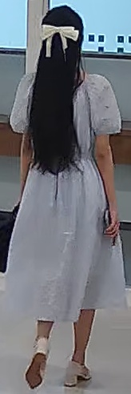
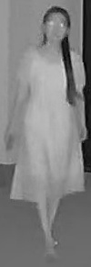
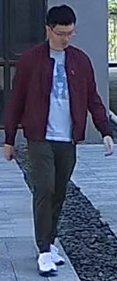
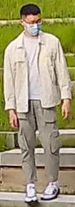
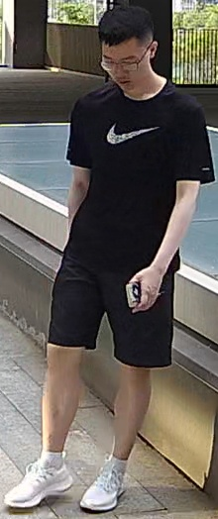
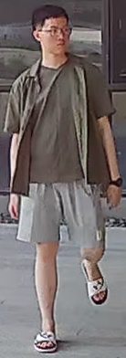
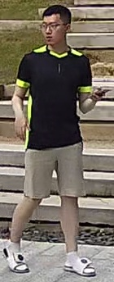
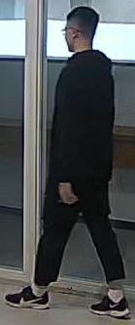
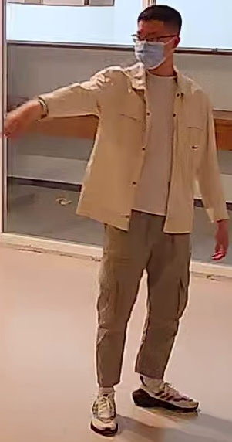
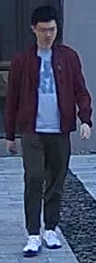
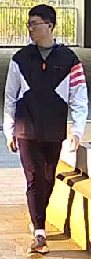
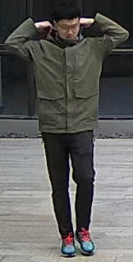
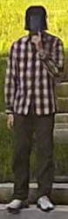
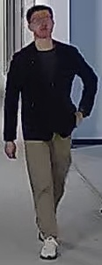
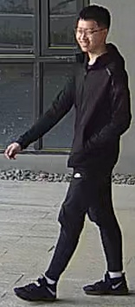
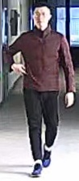
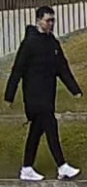
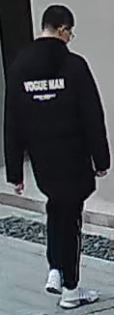
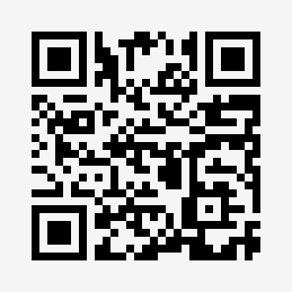
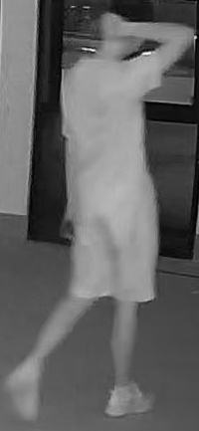
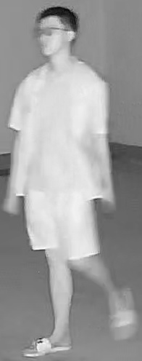
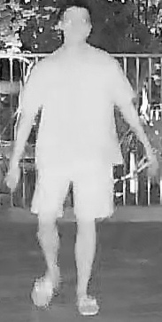
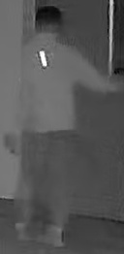
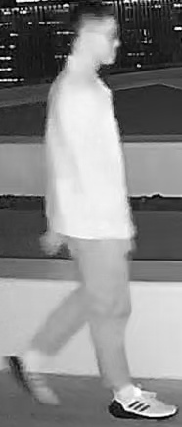
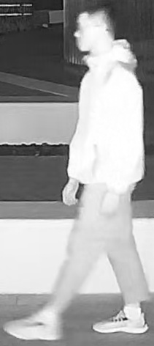
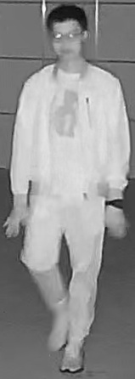
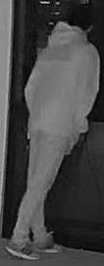
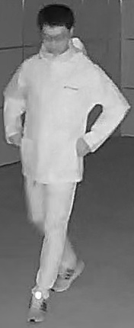
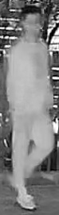
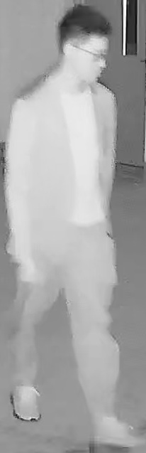
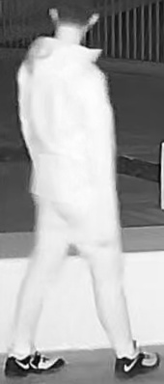
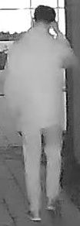

















Towards Anytime Retrieval: A Benchmark for Anytime Person Re-Identification
Xulin Li, Yan Lu, Bin Liu, Jiaze Li , Qinhong Yang , Tao Gong , Qi Chu , Mang Ye and Nenghai Yu
New Task: Anytime Re-ID
New Dataset: AT-USTC
New Multi-Task Method: Uni-AT
Background
In real applications, person re-identification (ReID) expects to retrieve the target person at any time, including both daytime and nighttime, ranging from short-term to long-term.
Case 1
Dataset
To address the AT-ReID problem, we collect the first large-scale dataset, AT-USTC, which covers all 6 scenarios in AT-ReID.
AT-USTC
Multi-Scenario ReID framework
6 CLS tokens for 6 scenarios and shared patch tokens.
Extract different features for different scenarios separately to capture specific clues in each scenario.
Day
Case 2
Advantages
270 volunteers and 135K images, obtained the consent of each volunteer
5 indoor and 11 outdoor scenes
8 RGB and 8 IR cameras
2-14 (avg 3.6) outfits per person for training, rich clothing types (-3◦C ~ 33◦C)
>1 year collection, 13 dates and 26 different time periods during spring, summer, and winter
29.1 videos per person (different dates or scenes), 4-15 times more than current datasets, high intra-identity diversity
Organized shooting and accurate labeling (variations in scenes, clothing, modality)
Good generalization ability (cross-domain testing)
Scenario-aware identity loss
Different scenarios have non-shared classifiers, distinct negative category sets, and different modality filtering mechanisms.
Challenge
The capturing time of images make ReID task more variable. Daytime: RGB modality. Nighttime: Infrared modality.
Short-term: Same clothes.
Long-term: Clothes changes.
Spring
Case 3
Case 4
Winter
AT-USTC
Mixture-of-Attribute-Experts
MoE to alleviate interference between scenarios. We define the attribute layer as the basic cell shared among experts with similar scenario attributes. With this, the model can benefit from multiple inter-related scenarios.
Night
Case 5
Case 6
Existing works
Attempted to address these problems separately.
Traditional ReID (Tr-ReID)
Visible-Infrared Cross-Modality ReID (CM-ReID)
Long-Term Cloth-Changing ReID (CC-ReID)
Success in one of specific tasks and incapable of retrieving targets at any time simultaneously.
cam10
Hierarchical Dynamic Weighting
Balances the training for different tasks with a loss weighting scheme, which considers multiple relevant tasks when computing weights.
cam9
cam11
cam1
cam15
cam16
Tr-
ReID
Daytime
CM-ReID
All-day
CC-ReID
Daytime
cam14
cam12
cam8
cam2
RGB camera
RGB IR
RGB camera
cam5
cam6
cam13
cam7
cam4
cam3
Scenario : DT-ST
Scenario : AD-ST
Long-
term
Scenario : DT-LT
Summer Spring Winter
RGB
IR
Day
Scene
Night
Scene
Building or Room
Short-
term
Short-
term
Clothes
changes
Link
Framework
Scenario-Aware Identity Loss
Patch
Token
Scenario Head
*
*
*
Gating
Weighted
sum
Same clothes
Same clothes
Task2
Task3
…
*
Scenario
CLS Token
Position
Embedding
*
Select
Expert
*
Transformer Layer
FFN
MoAE
*
…
*
Our work
We investigate a new task called Anytime Person Re-identification (AT-ReID), which aims to achieve effective retrieval in multiple scenarios based on variations in time.
Confidence
(Time Interval)
…
Norm
*
*
Capture Times/Videos Per Person: 29.1
Transformer Layer
[ DT ]
*
Conclusion
DT-ST
Confidence
(Time Moment)
0
*
1
*
…
5
*
6
7
8
…
13
Self-Attention
[ NT ]
…
…
Task1
Linear Projection
[ AD ]
*
NT-ST
We investigate a new task called AT-ReID, which aims at enabling retrieval at any time moment and across different time intervals.
We contribute for the first time a large-scale dataset named AT-USTC to support the study of AT-ReID. Compared to existing datasets, AT-USTC stands out for its long data collection period and the inclusion of both RGB and IR camera footages, meeting the requirement of AT-ReID.
We propose a Uni-AT model to effectively handle all scenarios of AT-ReID. In Uni-AT, three components proposed to tackle the new challenges of multi-scenario retrieval in AT-ReID.
Loss weight
…
Norm
[ ST ]
…
…
*
*
*
[ LT ]
*
6 non-overlapping scenarios based on variations in time.
3 existing +
3 absent scenarios NT-ST, AD-ST, AD-LT.
Multi-scenario generalization.
AT-
ReID
Daytime
All-day
Nighttime
AT-USTC
Dataset
Attribute
layers
Experts
(FFN)
AD-LT
RGB camera
RGB IR
IR camera
Hierarchical Dynamic Weighting (HDW)
Multi-Scenario ReID (MS-ReID)
Mixture-of-Attribute-
Experts (MoAE)
Scenario : DT-ST
Scenario : AD-ST
Scenario : NT-ST
Short-
term
Experiments
Same clothes
Scenario : DT-LT
Scenario : AD-LT
Scenario : NT-LT
Uni-AT method
Multi-scenario learning
AT-USTC dataset
Cover all scenarios
Long-
term
DT-ST
DT-LT
AD-ST
AD-LT
NT-ST
NT-LT
AT-ReID task
Anytime retrieval
Clothes
changes
Tr-ReID
CC-ReID
CM-ReID
absent
absent
absent

Slide 2

Towards Anytime Retrieval: A Benchmark for
Anytime Person Re-Identification
ID: 2068
Xulin Li, Yan Lu, Bin Liu*, Jiaze Li , Qinhong Yang , Tao Gong , Qi Chu , Mang Ye and Nenghai Yu
New Task: Anytime Re-ID
New Dataset: AT-USTC
Background
In real applications, person re-identification (ReID) expects to retrieve the target person at any time, including both daytime and nighttime, ranging from short-term to long-term.
Day
Case 1
Dataset
To address the AT-ReID problem, we collect the first large-scale dataset, AT-USTC, which covers all 6 scenarios in AT-ReID.
AT-USTC
Case 2
Advantages
270 volunteers and 135K images, obtained the consent of each volunteer
5 indoor and 11 outdoor scenes
8 RGB and 8 IR cameras
2-14 (avg 3.6) outfits per person for training, rich clothing types (-3◦C ~ 33◦C)
>1 year collection, 13 dates and 26 different time periods during spring, summer, and winter
29.1 videos per person (different dates or scenes), 4-15 times more than current datasets, high intra-identity diversity
Organized shooting and accurate labeling (variations in scenes, clothing, modality)
Good generalization ability (cross-domain testing)
Challenge
The capturing time of images make ReID task more variable. Daytime: RGB modality. Nighttime: Infrared modality.
Short-term: Same clothes.
Long-term: Clothes changes.
Spring
Case 3
Case 4
Winter
Case 6
AT-USTC
Night
Case 5
Existing works
Attempted to address these problems separately.
Traditional ReID (Tr-ReID)
Visible-Infrared Cross-Modality ReID (CM-ReID)
Long-Term Cloth-Changing ReID (CC-ReID)
Success in one of specific tasks and incapable of retrieving targets at any time simultaneously.
cam10
cam11
cam15
All-day
cam9
cam1
cam16
Tr-
ReID
Daytime
CM-ReID
RGB IR
CC-ReID
Daytime
cam2
RGB camera
RGB camera
cam14
cam12
cam8
Scenario : DT-ST
Scenario : AD-ST
Long-
term
Scenario : DT-LT
cam5
cam6
cam13
cam7
cam4
cam3
Short-
term
Short-
term
Clothes
changes
Summer Spring Winter
RGB
IR
Day
Scene
Night
Scene
Building or Room
Same clothes
Same clothes
Link
Our work
We investigate a new task called Anytime Person Re-identification (AT-ReID), which aims to achieve effective retrieval in multiple scenarios based on variations in time.
Capture Times/Videos Per Person: 29.1
6 non-overlapping scenarios based on variations in time.
3 existing + 3 absent scenarios NT-ST, AD-ST, AD-LT.
Multi-scenario generalization.
AT-
ReID
Daytime
All-day
Nighttime
Framework and Experiments
RGB camera
RGB IR
IR camera
Scenario : DT-ST
Scenario : AD-ST
Scenario : NT-ST
Framework
Scenario-Aware Identity Loss
Patch
Token
Scenario Head
*
*
*
Gating
Weighted
sum
Short-
term
Task2
Task3
…
*
Scenario
CLS Token
Position
Embedding
*
Expert
*
Same clothes
Transformer Layer
FFN
MoAE
*
Select
…
*
Scenario : DT-LT
Scenario : AD-LT
Scenario : NT-LT
Confidence
(Time Interval)
…
Norm
*
*
Long-
term
Transformer Layer
[ DT ]
*
DT-ST
Clothes
changes
Confidence
(Time Moment)
0
*
1
*
…
5
*
6
7
8
…
13
Self-Attention
[ NT ]
…
…
Task1
Linear Projection
[ AD ]
*
NT-ST
Loss weight
…
Norm
[ ST ]
…
…
New Multi-Task Method: Uni-AT
*
*
*
[ LT ]
*
Hierarchical Dynamic Weighting (HDW)
AT-USTC
Dataset
Multi-Scenario ReID (MS-ReID)
Mixture-of-Attribute-
Experts (MoAE)
Attribute
layers
Experts
(FFN)
AD-LT
Multi-Scenario ReID framework
6 CLS tokens for 6 scenarios and shared patch tokens.
Extract different features for different scenarios separately to capture specific clues in each scenario.
Experiments
Scenario-aware identity loss
Different scenarios have non-shared classifiers, distinct negative category sets, and different modality filtering mechanisms.
Conclusion
Mixture-of-Attribute-Experts
MoE to alleviate interference between scenarios. We define the attribute layer as the basic cell shared among experts with similar scenario attributes. With this, the model can benefit from multiple inter-related scenarios.
We investigate a new task called AT-ReID, which aims at enabling retrieval at any time moment and across different time intervals.
We contribute for the first time a large-scale dataset named AT-USTC to support the study of AT-ReID. Compared to existing datasets, AT-USTC stands out for its long data collection period and the inclusion of both RGB and IR camera footages, meeting the requirement of AT-ReID.
We propose a Uni-AT model to effectively handle all scenarios of AT-ReID. In Uni-AT, three components proposed to tackle the new challenges of multi- scenario retrieval in AT-ReID.
Hierarchical Dynamic Weighting
Balances the training for different tasks with a loss weighting scheme, which considers multiple relevant tasks when computing weights.
Uni-AT method
Multi-scenario learning
AT-USTC dataset
Cover all scenarios
DT-ST
DT-LT
AD-ST
AD-LT
NT-ST
NT-LT
AT-ReID task
Anytime retrieval
Tr-ReID
CC-ReID
CM-ReID
absent
absent
absent

